Slide 1
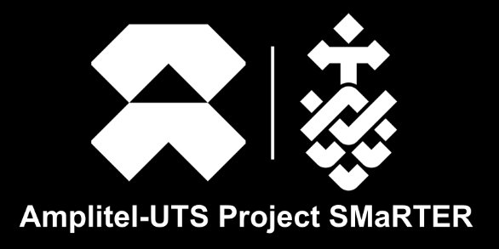
Systematic Measurement and Remediation Techniques for Enhanced Tower Reliability​

Slide 2
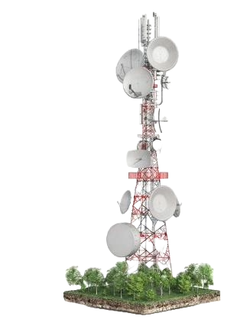
Predictive Analytics and Maintenance Optimization
ML models trained on historical data and environmental patterns
Risk-prioritized maintenance scheduling for tower networks
Optimized resource allocation and reduced outages
Structural Fingerprinting & Digital Twin Modelling​
High-fidelity digital fingerprints using multimodal sensors​
Real-time structural health monitoring and anomaly detection​
​
Autonomous Robotic Inspection and Micro-Remediation
Climbing robots and UAVs with high-definition imaging
Non-invasive inspections and autonomous remediation
Enhanced safety and inspection efficiency

